Slide 1
Let us start with a laugh
Project Management Humor
By
NK Shrivastava
PMP, PMI-RMP
CEO - RefineM
VP – PMI Southwest Missouri Chapter
nks@refinem.com, http://www.linkedin.com/in/nkshrivastava @justrightpm

Slide 2
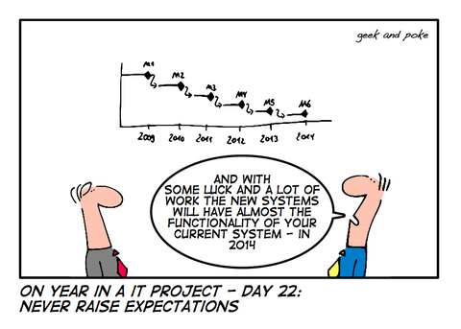
No Surprises ☺

Slide 3
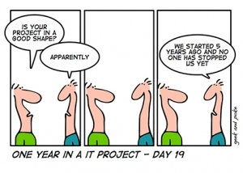
Smooth sailing ☺

Slide 4
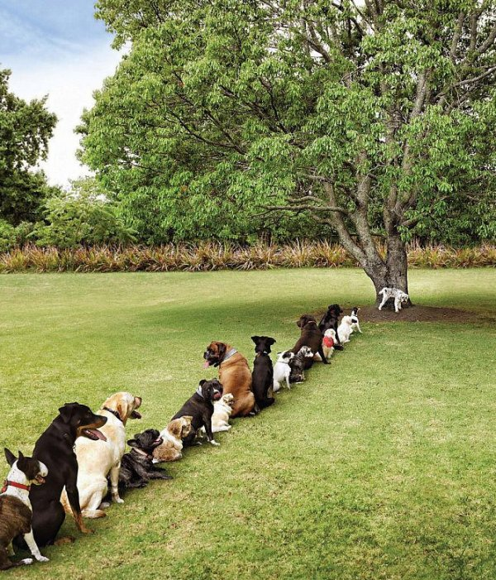
Plan before you execute ☺
Deforestation

Slide 5
Project Management Proverbs ☺
Any task, no matter how complex, can be estimated accurately, once it's complete
The sooner you fall behind the project schedule, the more time you have to make it up
If you don't attack the project risks, the project risks will attack you
When all's said and done, a lot more was said then was done

Slide 6
The Project Manager ☺
A tourist walked into a pet shop and was looking at the animals on display. While he was there, another customer walked in and said to the shopkeeper, "I'll have a C monkey please." The shopkeeper nodded, went over to a cage at the side of the shop and took out a monkey. He fitted a collar and leash, handed to the customer, saying, "That'll be $5,000.“
The customer paid and walked out with his monkey. Startled, the tourist went over to the shopkeeper and said, "That was a very expensive monkey. Most of them are only a few hundred pounds. Why did it cost so much? "The shopkeeper answered, "Ah, that monkey can program in C - very fast, tight code, no bugs, well worth the money.“
The tourist looked at a monkey in another cage. "Hey, that one's even more expensive! $10,000! What does it do?“ "Oh, that one's a C++ monkey; it can manage object-oriented programming, Visual C++, even some Java All the really useful stuff," said the shopkeeper.
The tourist looked around for a little longer and saw a third monkey in a cage of its own. The price tag around its neck read $50,000.The tourist gasped to the shopkeeper, "That one costs more than all the others put together! What on earth does it do?“
The shopkeeper replied, "Well, I haven't actually seen it do anything, but it says it's a project manager".

Slide 7
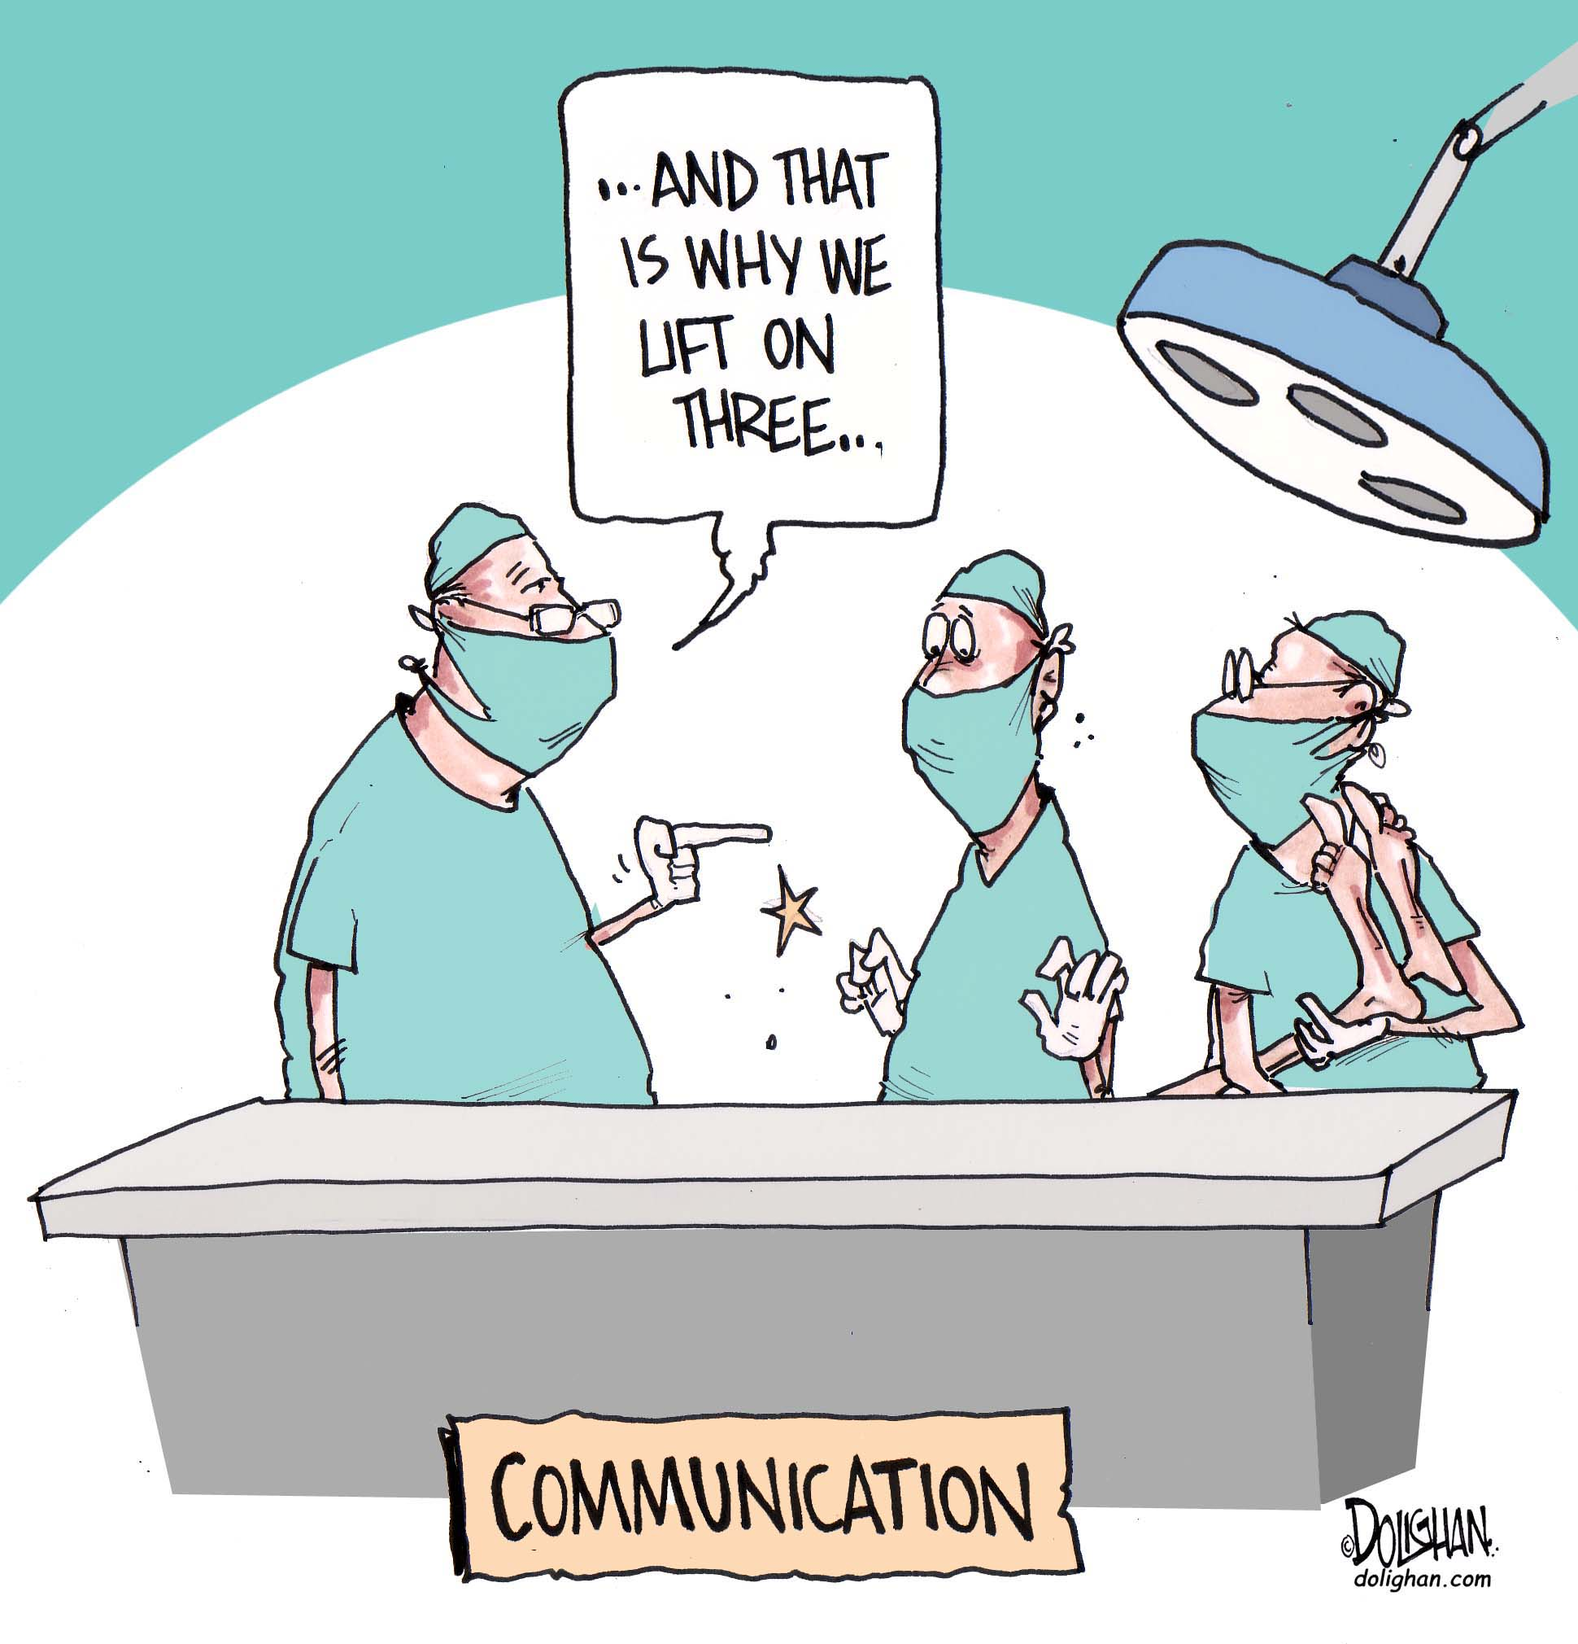

Slide 8
Have some more fun ☺
Are you agile?
http://www.youtube.com/watch?v=4IJYveGZLUc

Slide 9
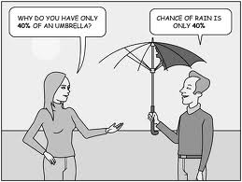
Managing Risks ☺

