Slide 1
Mastering the Role of Product Owner: Best Practices
NK Shrivastava, PMP, RMP, ACP, CSP, SPC4, ICP-ACC​ CEO/Enterprise Agile Coach

Slide 2
Agenda
Section
Topics
1
Introductions and Expectations
2
Introduction to Agile
3
Who is a Product Owner?
Roles / Responsibilities
Who Can Be a Product Owner?
4
Product Owner Best Practices
4
Keys to Being an Effective Product Owner
5
Quiz
6
Conclusion
7
Q&A
www.RefineM.com

Slide 3
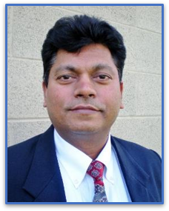
NK Shrivastava, Certified Enterprise Agile Coach
MBA, ICP-ACC, ACP, CSP, SPC4, PMP, RMP
http://www.linkedin.com/in/nkshrivastava
CEO/Enterprise Agile Coach @ RefineM since Dec 2011
Agile Transformation/Coaching (IBM, Charter, Wells Fargo …)
Project Management/Process Improvement Consulting
Project Management and Agile Training
PMP Exam Prep - https://refinem.com/pmp-exam-prep-course-public/
PMI-ACP Exam Prep - https://refinem.com/pmi-acp-exam-prep-course-public/
Agile Leadership - https://refinem.com/agile-leadership-course/
Self-Paced Online Training - https://refinem.com/self-paced-online-trainings/
Product Creation for Project and Agile Professionals
Essential Gear for Project Managers - RefineM.com/products/essential-gear-for-project-managers/
PMP Exam Simulator - RefineM.com/pmp-exam-prep-practice-test/
Agility Assessment Tool - Agility.RefineM.com/
Videos – PMP and Agile - https://vimeo.com/search?q=RefineM
25+ years of successful Agile & Project leadership before Launching RefineM
Successfully led hundreds of projects of all sizes using Waterfall and/or Agile
Recovered many projects, saved millions of dollars
Implemented numerous process improvements
Coached/mentored hundreds of PMs and executives
Board member of SWMO PMI Chapter (2008-2014)
Helping organizations achieve excellence in delivering business outcomes within 8-12 weeks through Agile Coaching
Partner
www.RefineM.com
Born in Meerut, a small town in north India. Now lives in Cary, NC with wife and kids

Slide 4
Survey Question
What are your expectations for this webinar?
Why are you here today?
Go to menti.com to answer
www.RefineM.com

Slide 5
What’s New at RefineM
Upcoming Free Webinar | Date
Mastering the Role of Product Owner: Best Practices (projectmanagement.com) | Nov 17
RefineM Products | Self-Paced Online Training
Essential Gear for Project Managers RefineM.com/products/ | Agile Fundamentals Self-Paced Course RefineM.com/course/agile
PMP® Exam Prep Test Simulator Examprep.RefineM.com | PM Fundamentals Self-Paced Course Refinem.com/course/project-management-fundamentals/
Agility Assessment Agility.RefineM.com | Agile BusReqs Self-Paced Course https://vimeo.com/ondemand/refinembusreq
PDU Bundle https://vimeo.com/ondemand/refinempdus | Backlog Grooming Self-Paced Course Udemy.com/course/backlog-grooming-for-agile-requirements/
www.RefineM.com

Slide 6
Survey Question
Does your organization currently use an Agile, Hybrid, or Waterfall approach?
Vote on menti.com
6
www.RefineM.com

Slide 7
Survey Question
What kind of roles have you played on Agile projects?
Vote on menti.com
7
www.RefineM.com

Slide 8
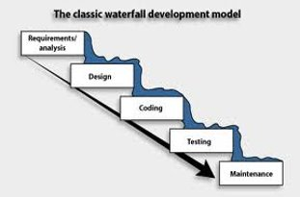
Issues with Waterfall Methodology
No value delivered until the end​
Heavy upfront planning​
Enormous documentation​
No customer involvement during development​
Numerous change requests​
QA/testing – a sticker shock​
Cost overruns, delays resulting in project failures (70%)
What other issues have you seen with Waterfall?
www.RefineM.com
Notes:
Also known as “Predictive” life cycle
Planning on scope, schedule, and budget are completed as upfront as possible.
Value delivered mostly at the end of the project after work complete.
Change can be disruptive and is therefore resisted.

Slide 9
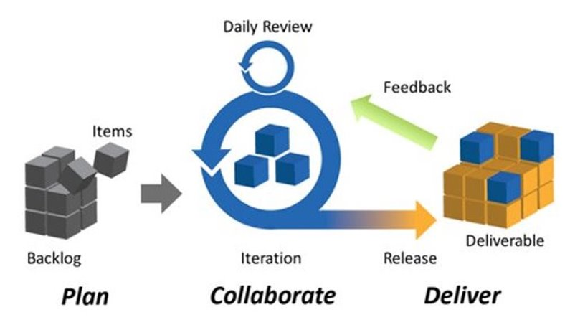
Agile
www.RefineM.com
Notes:
Also known as “Adaptive” lifecycle - value delivered is more frequent and upfront
Teams follow the same process through iterations or sprints to build the product in increments based on a product core.
Allows for more customer involvement and greater flexibility to respond to change.

Slide 10
Waterfall vs. Agile
Waterfall​ | Agile​
Fixed scope. Time/cost estimated​ | Fixed time/cost. Flexible scope​
Clear picture of the end product​ | Product evolves over time​
Product over process​ | Process over product​
Delivery at the end​ | Continuous delivery throughout​
Change requests controlled/resisted​ | Changes welcomed, even late​
10
www.RefineM.com
Notes:
A hybrid approach incorporates aspects from both predictive/Waterfall and adaptive/Agile methods.
Ex. Planning and requirements are set (waterfall), then an iterative process is used for implementation (agile), and the project is verified and delivered to the customer at the end (waterfall).​

Slide 11
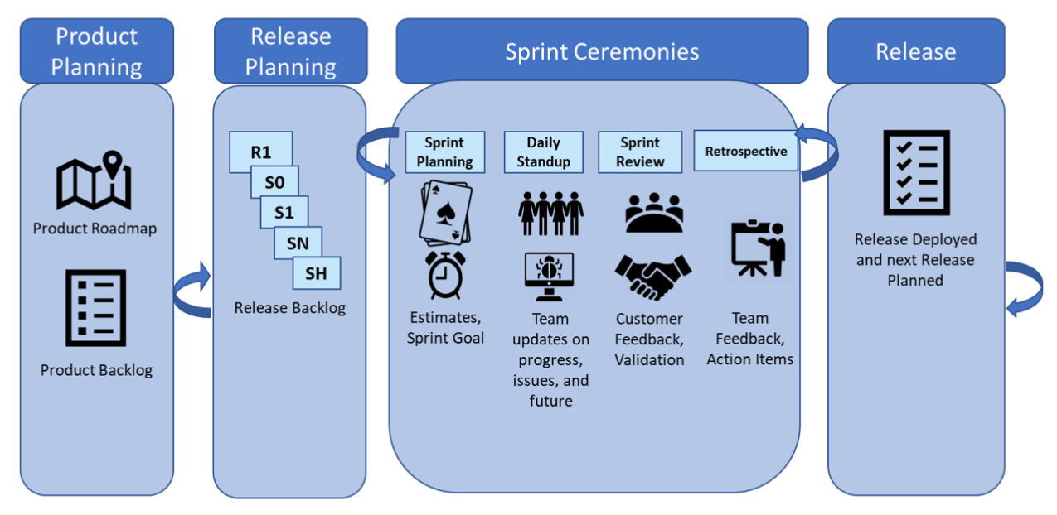
Scrum
www.RefineM.com

Slide 12
Scrum Roles
Product Owner – represents the stakeholders and is the voice of the customer. Responsible for ensuring the team delivers value to the business. Develops and maintains product backlog.
Scrum Master – responsible for helping the team follow the Scrum process. Accountable for removing impediments to the ability of the team to deliver the sprint goal/deliverables.
Developers – anyone involved in creating the product increment, mostly generalizing specialists but may utilize a variety of skillsets.
www.RefineM.com

Slide 13
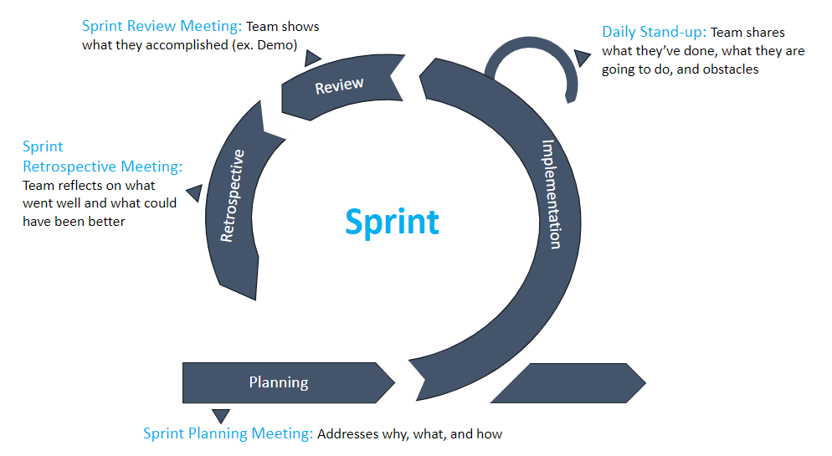
Scrum Ceremonies
Sprint Review Meeting: Team shows what they accomplished (ex. Demo)
PO: Answers questions to clarify product functions, expectations, and approve user stories as DONE
Daily Stand-up: Team shares what they’ve done, what they are going to do, and obstacles
PO: Is present to receive feedback from developers for refine user stories and manage the backlog
Sprint Retrospective Meeting: Team reflects on what went well and what could have been better
PO: Is present with the team to maximize the value brought to the event for future improvements
Sprint Planning Meeting: Addresses why, what, and how
PO: Provides description of user stories having the highest priority to the team and answers questions about User Stories to create more detailed tasks for the backlog
www.RefineM.com

Slide 14
Who is a Product Owner?
“Owns” product on behalf of customer​
“Voice of the customer”​
Develops and “drives” vision of product​
Creates product roadmap and drives user stories​
Supports Scrum Master to develop release and sprint plans
PO is the Driver of an Agile Project
No PO = No Agile project
www.RefineM.com
Source: Cohn, Mike (2014). "Scrum Product Owner: The Agile Product Owner's Role." Mountain Goat Software. Web. http://www.mountaingoatsoftware.com/agile/scrum/product-owner/ ​

Slide 15
Who Can Be a Product Owner?
Anyone can take the role​
Some candidates better than others​
Ideal Candidates​ | Not So Ideal​
Product manager​ | Project manager​
Business analyst​ | Information analyst​
Business expert​ | Unit manager​
Lead user​ | Developer​
Marketing specialist​ | Tester
Could Scrum master be an effective PO?​
What about the Customer?​
www.RefineM.com

Slide 16
Roles / Responsibilities
“Wears many hats”​
Maximizes Value Delivered​
Creates product vision​
Develops product roadmap​
Creates and manages product backlog​
Drives creation of user stories​
Develops and Drives Product Vision​
Interacts with Stakeholders​
Supports release, sprint planning​
Ensures team works on high-value items​
www.RefineM.com

Slide 17
Product Vision
What is a product vision statement?
It sets the direction for business planning
It tells you what to reach for but not how to get there
For [customer] who has [need/opportunity], our [product] is a [product category] that provides [key benefit/solution] by [differentiator]
Example: For education administrators who need to be able to track student progress district-wide, our tracking tool is a cloud-based software tool that provides real-time tracking by utilization of faster servers than any of our competition.
www.RefineM.com

Slide 18
Product Vision- PO’s Role
Product Owner role:
Develops product vision from shared understanding of the goal to be achieved for the product.
Communicates the product vision clearly with the team throughout the project
www.RefineM.com

Slide 19
Product Roadmap & Strategy
What is a product roadmap?
High-level plan that describes how the product is likely to grow. ​
It allows you to express where you want to take your product.
www.RefineM.com

Slide 20
Product Strategy/Roadmap- PO’s Role
Product Owner roles:
Validates product strategy
What do we want to accomplish with this product?
Develops product’s roadmap
Who is in the audience? How will the product grow?
Gets buy-in
Agreement on strategy helps development
www.RefineM.com

Slide 21
Product Roadmap – PO Best Practices
Concentrate on high-level themes, not detailed requirements​
Details can come later—map is for vision​
Make sure roadmap answers following:​
What are the relative priorities of each part?​
When do we intend to work on each part?​
Keep a master copy easily accessible​
Team members need to be able to see latest agreed-upon copy
What else?
www.RefineM.com

Slide 22
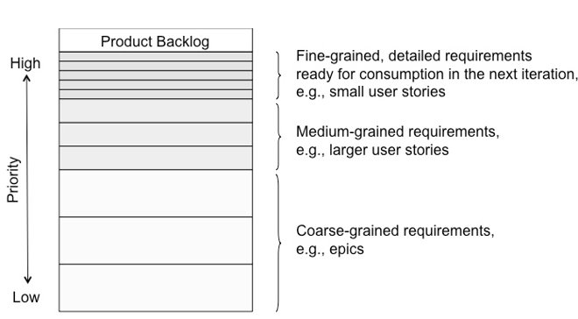
Backlog Management
PO’s Role - Work with the team to manage and prioritize the backlog often
www.RefineM.com

Slide 23
Release Planning
Must-Haves
User Story
Product Owner role:
Identify release goals
Present prioritized product backlog
Do not over plan/overcommit
User Story
Priorities for this release
User Story
Scrum Master role:
Facilitate the ceremony
Identify and resolve issues
Remove barriers to team success
Should-Haves
User Story
User Story
Could-Haves
Fit in if possible
User Story
User Story
www.RefineM.com

Slide 24
Product Owner Challenges
Determining & Communicating the business value
Defining the User well enough
Prioritizing effectively
Getting buy-in from stakeholders & the team
www.RefineM.com

Slide 25
Summary of Best Practices
Focus on increasing value
Refine the backlog on a regular basis
Collaborate with customers and the team
Be ‘product oriented’ over ‘project oriented’
Take responsibility
www.RefineM.com

Slide 26
Critical Success Factors to be an Effective Product Owner
Value Focused
Determine & communicate value for each feature, epic and story
Maximize value for each iteration/release
Ensure team works on high value items all the times
Thoroughly understanding customer needs​
Creating epics/user stories
Actively managing stakeholders​
Bridge between company and client
Juggle differing feedback
Having basic knowledge of software development
Enough to make informed decisions & communicate with developers
Support the scrum process
Attend retrospectives and daily meetings
Support & work with the team
As product owner, you are in the driver’s seat, why?​
www.RefineM.com

Slide 27
Quiz
Go to menti.com to answer
Top 2 Winners get free access (100% discount)
to one of RefineM's products of their choice
Essential Gear for Project Managers ($89)
PMP Exam Prep Simulator – 3 months ($100)
Agility Assessment – 3 months ($99)
PDU Bundle - 2 months ($98)
Self-Paced Online Course ($100 each)
Agile Fundamentals, or
Project Management Fundamentals
www.RefineM.com

Slide 28
Questions
Questions?
NK Shrivastava, MBA, PMP, RMP, ACP, CSP, SPC4
CEO/Enterprise Agile Coach, RefineM
Cary, NC
nks@refinem.com, www.refinem.com
http://www.linkedin.com/in/nkshrivastava
@justrightpm
Email us if you would like this or a similar webinar delivered for your team/ department/ organization.
Trainings@RefineM.com
There is no fee for such webinars, where the main purpose is learning and sharing.
www.RefineM.com

Slide 29
Training Opportunities from RefineM
Agile Courses | Online
Backlog Grooming for Agile Requirements | Oct 20
Agile Fundamentals | Nov 14
PMI-ACP® Exam Prep | Nov 14
Agile for Waterfall/Operational Work | Nov 17
Project Management Courses | Online
PMP® Exam Prep *Guarenteed to run* | Nov 4
CAPM® Exam Prep | Nov 27
Project Management Fundamentals | Nov 7
Recipe to Deliver Projects Successfully | Nov 3
Leadership Courses | Online
Agile Leadership | Nov 9
Leadership Skills for Project Managers | Oct 27
Data Analytics | Online
Dashboard in a Day with PowerBI | Oct 25
Data Analytics with PowerBI | Oct 27
www.RefineM.com

Slide 30
How to Earn 1 PDU for this Webinar?
Log in to ccrs.pmi.org and Click on “Report PDUs” link.
Click “Courses and Training” and Input the following:
PDU Claim Code | 3990D7LG3T
Activity Name | “Masting the Role of Product Owner: Best Practices”
Provider | “RefineM LLC”
Date Started/Completed | October 12, 2023
Contact Person | NK Shrivastava
Contact Phone | (417) 763-6762
Contact Email | Trainings@RefineM.com
PDUs | 1.00 Ways of Working.
Check “I agree this claim is accurate” box and then Submit.
Please claim your PDU by end of November 2023.
Claim code will expire after that date.

